Slide 1
2023 Wachusett Shores and PPOA Annual Meeting
Sunday May 21, 2023

Slide 2
Agenda
Welcome
Minutes of 2022 PPOA Annual Meeting
Treasurer’s Report
Thanks to all who help keep the Association running
Old Business
Cushman Pond Restoration
New Business
Vote and set the 2024-2025 Annual Membership and Deed Assessment Fee
Elections
Q&A
Adjournment

Slide 3
Minutes of May 2022 Annual Meeting Annual Meeting Minutes

Slide 4
Treasurer’s Report

Slide 5
TOTAL NET WORTH as of 3/31/2023
Real Estate (Lodge and Land) | $125,650.00
Investment portfolio | $238,874.00
Cash | $19,751.07
Total assets | $384,275.07
Total liability | $0.00
Net worth | $384,275.07

Slide 6
Investment Portfolio

Slide 7
Payments History (FY'2018 - FY'2023)
Payment as of date of Annual Meeting. 2023 Bills were mailed late so payments are lower than usual.

Slide 8
Edward Jones Asset Allocation
Total Portfolio as of March 31, 2023

Slide 9
FY 2023 Expenses
EXPENSES | BUDGET | ACTUAL | VARIANCE
Town Real Estate Taxes | $ 2,300.00 | $ 1,667.43 | $ 632.57
Porta Potti for beach | $ 1,450.00 | $ 781.76 | $ 668.24
Charter Communications – Internet, phone | $ 3,200.00 | $ 3,441.28 | $ (241.28)
National Grid (Electric) | $ 1,000.00 | $ 1,299.34 | $ (299.34)
Trash (E.L. Harvey and Sons & Republic) | $ 575.00 | $ 483.03 | $ 91.97
Security Alarm Systems | $ 216.00 | $ 257.70 | $ (41.70)
USPS (Stamps) | $ 200.00 | $ - | $ 200.00
Broberg Insurance (Liability & Lodge) | $ 6,267.32 | $ 6,267.32 | $ -
Huhtula Oil (Fuel) | $ 1,800.00 | $ 1,289.13 | $ 510.87
US Dept. of Rev /Mass/Annual report | $ 80.00 | $ - | $ 80.00
PO Box Annual Renewal | $ 64.00 | $ 70.00 | $ (6.00)
E.coli Test & Variance Survey | $ 280.00 | $ 331.50 | $ (51.50)
Web Site Hosting Renewal | $ 175.00 | $ 163.47 | $ 11.53
Lodge inspection: Town of Hubbardston | $ 40.00 | $ - | $ 40.00
Tax Accountant | $ 775.00 | $ 800.00 | $ (25.00)
Mailings/Meetings/Supplies | $ 300.00 | $ 445.45 | $ (145.45)
Spring Cleanup/Annual Beach Party | $ 500.00 | $ 656.80 | $ (156.80)
TOTAL OPERATING EXPENSES | $ 19,222.32 | $ 17,954.21 | $ 2,162.70

Slide 10
FY 2023 MAINTENANCE & IMPROVEMENTS
 | PLAN | ACTUAL YTD | VARIANCE
Lodge cleaning & supplies | $200.00 | $0 | $200.00
General Repairs & Maintenance | $2,000.00 | $5,176.19 | ($3,176.19)
Fuel / Supplies for Mowing, etc. | $100.00 | $89.13 | $10.87
Pond Maintenance (Solitude Lake Management and Other Expenses) | $21,036 | $20,305 | $731
TOT. MAINTENANCE & IMPROVEMENTS | $23,336.00 | $23,284.76 | $51.24

Slide 11
FY 2023 INCOME
INCOME | PLAN | ACTUAL YTD | VARIANCE
FY 2023 Maint. Fees (Plan: 186 x $200) | $ 34,800.00 | $ 21,968.00 | $ (12,832.00)
Past Due Maint Fees / Interest | $ 52,790.00 | $ 4,720.00 | $ (48,070.00)
Lodge Rentals | $ 500.00 | $ 400.00 | $ (100.00)
Interest (GFA Checking) | $ 7.00 | $ 6.85 | $ (.15)
Interest (GFA Savings) | $ 2.50 | $ 1.61 | $ (.89)
Other (Misc.) (refund from trash) | $ 0 | $ 448.74 | $ 448.74
Dock Fees | $ 150.00 | $ 150.00 | $ 0
Donation: Lions club for well repair |  | $ 1,000.00 | $ 1,000.00
Donations: Toward swing set |  | $ 2,475.00 | $ 2,475.00
TOTAL INCOME | $ 88,259.50 | $ 31,170.20 | $ (60,664.30)

Slide 12
Operating Budget

Slide 13
Thanks Volunteers!
Thank you to all of our neighbors who have volunteered to help PPOA throughout the year. It’s your neighborhood, and you help keep it running!

Slide 14
What PPOA Volunteers Accomplished
Hydro-raked and treated the pond
Well line has been fixed
New stove
Fan in the ladies room replaced
Lights in the kitchen replaced
Two clean-ups plus a lot of work on trails restoration outside of cleanup
New canoe racks
All boats on beach have been properly locked
Beach water testing
Sent out annual letter and billing
Sledding hill cleared
Grass mowed
Goose abatement
Lodge rental coordination
Friendship fireplaces
Welcome kits to new neighbors
Festive signs on the street
Flower arrangements for the lodge window boxes
Monthly meetings
And much more!

Slide 15
Old Business
Lodge Well
Pond Maintenance
Spring Cleanup
Lock and turn over your boat
Beach water testing
Goose abatement and trail Maintenance
Friendship Fireplace
Trash at the Lodge
Summer Beach Barbeque & Games
Multi-media for Lodge

Slide 16
PPOA Cushman Pond Restoration
By Jim Ellis

Slide 17
Cushman Pond July 2019

Slide 18
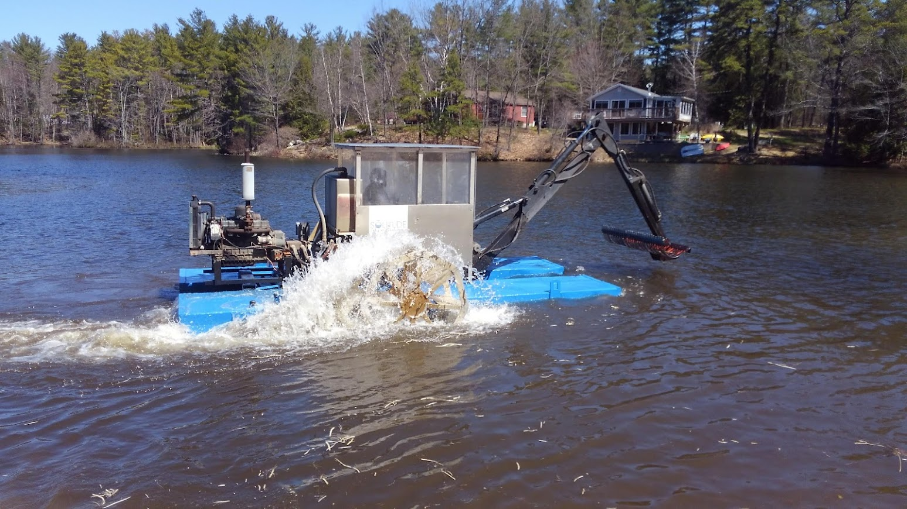
Hydroraking April 2022

Slide 19
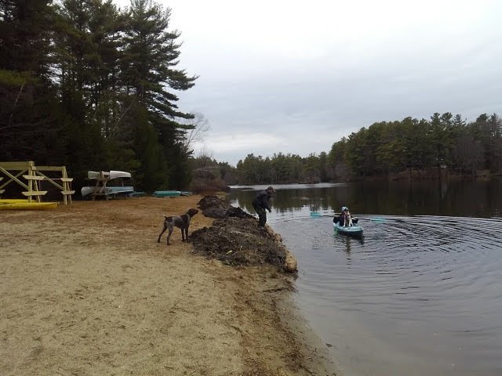
Dropping on the beach was efficient use of hydrorake time when working close by.

Slide 20
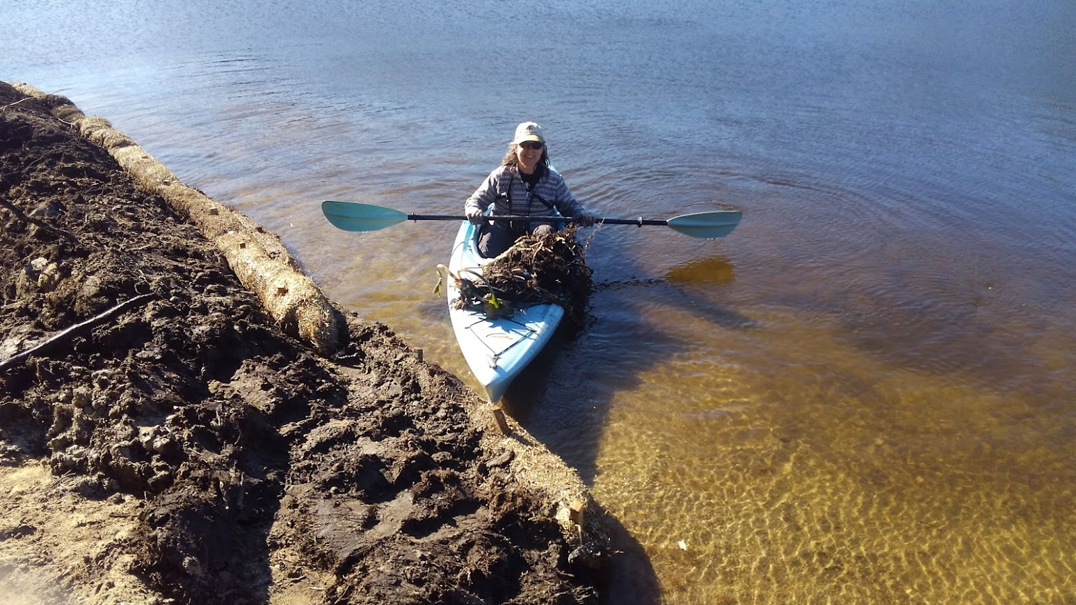
Break away floating plants needed constant collection

Slide 21
Cleaning up the material on the beach took more than a month of full time hours by Dave Blad, Jim Ellis, Lee and Jeanne Carter, Steve Kemp, Betty Ann Sharp, Bill Homans, Josh Adams, Bill Poudrier, Jay and Krista Goguen, Gail Orciuch, Tim Humphrey and others.

Slide 22
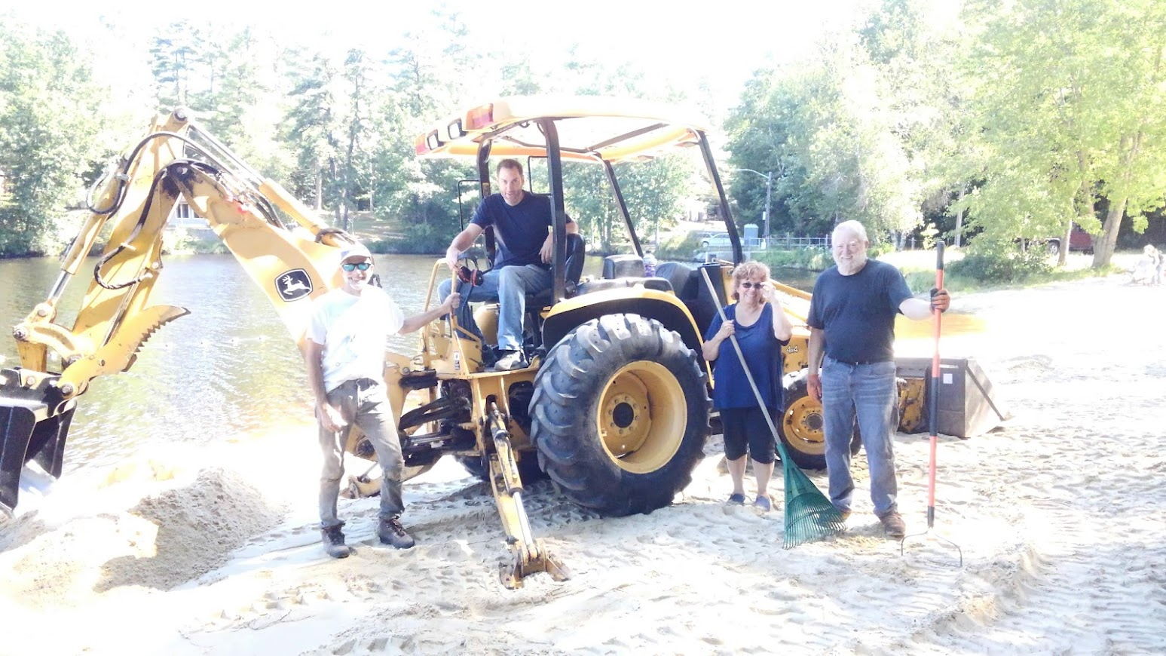
Without heavy equipment and time donations we would have failed.

Slide 23
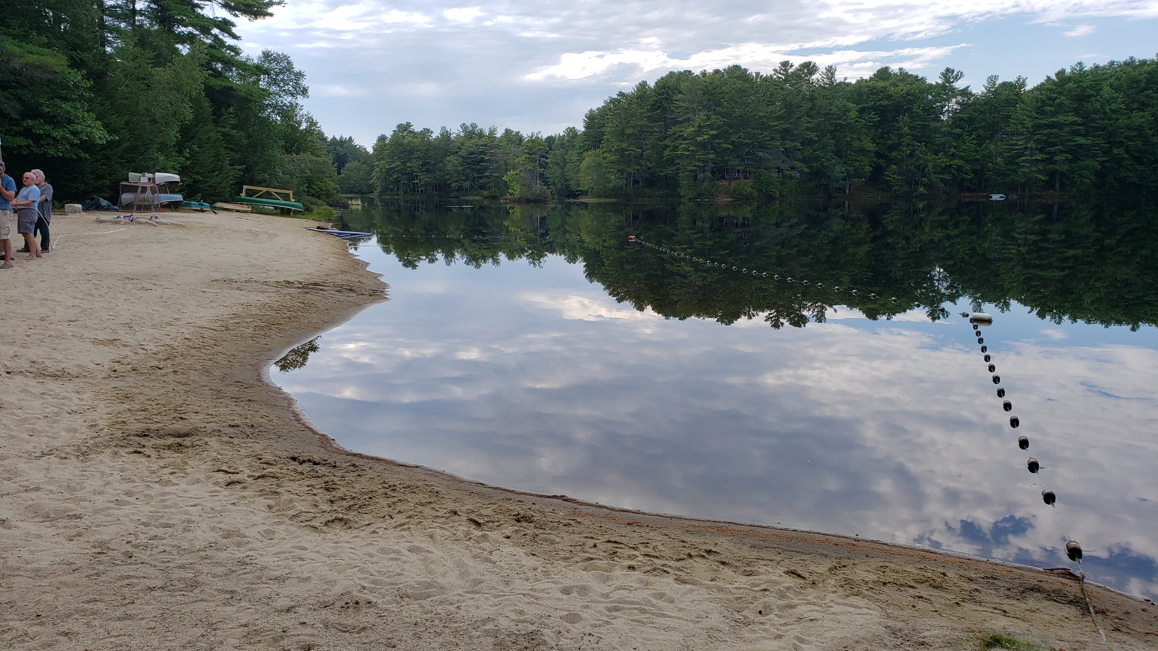
But wow doesn’t success look good!

Slide 24
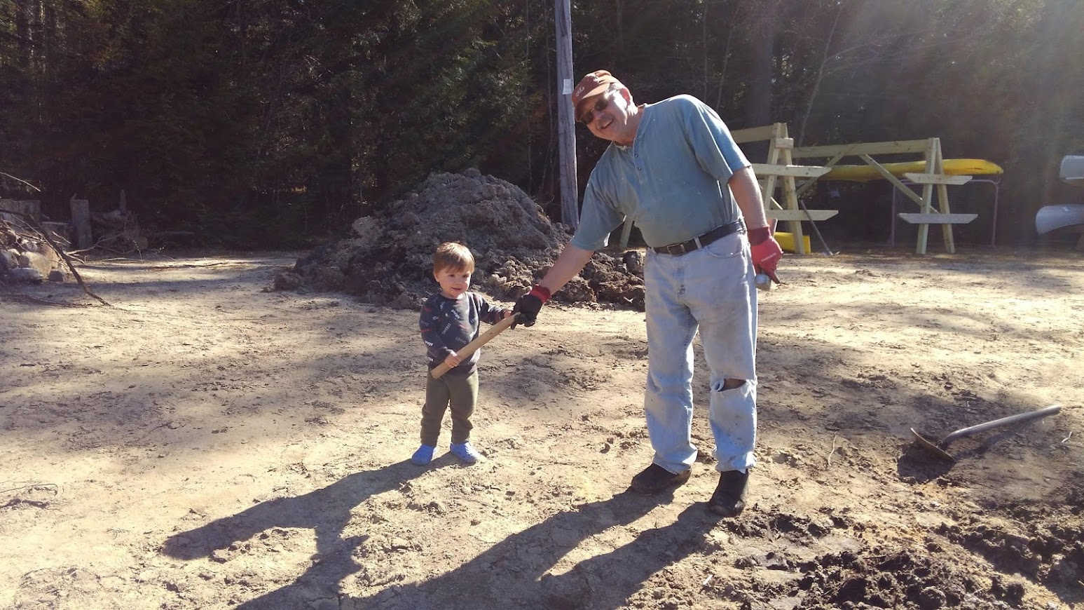
It truly was a community effort.

Slide 25
Dropping in a dump trailer was a clean solution, but if the rake was working close it required a truck operator to dump the trailer every 45 minutes.

Slide 26
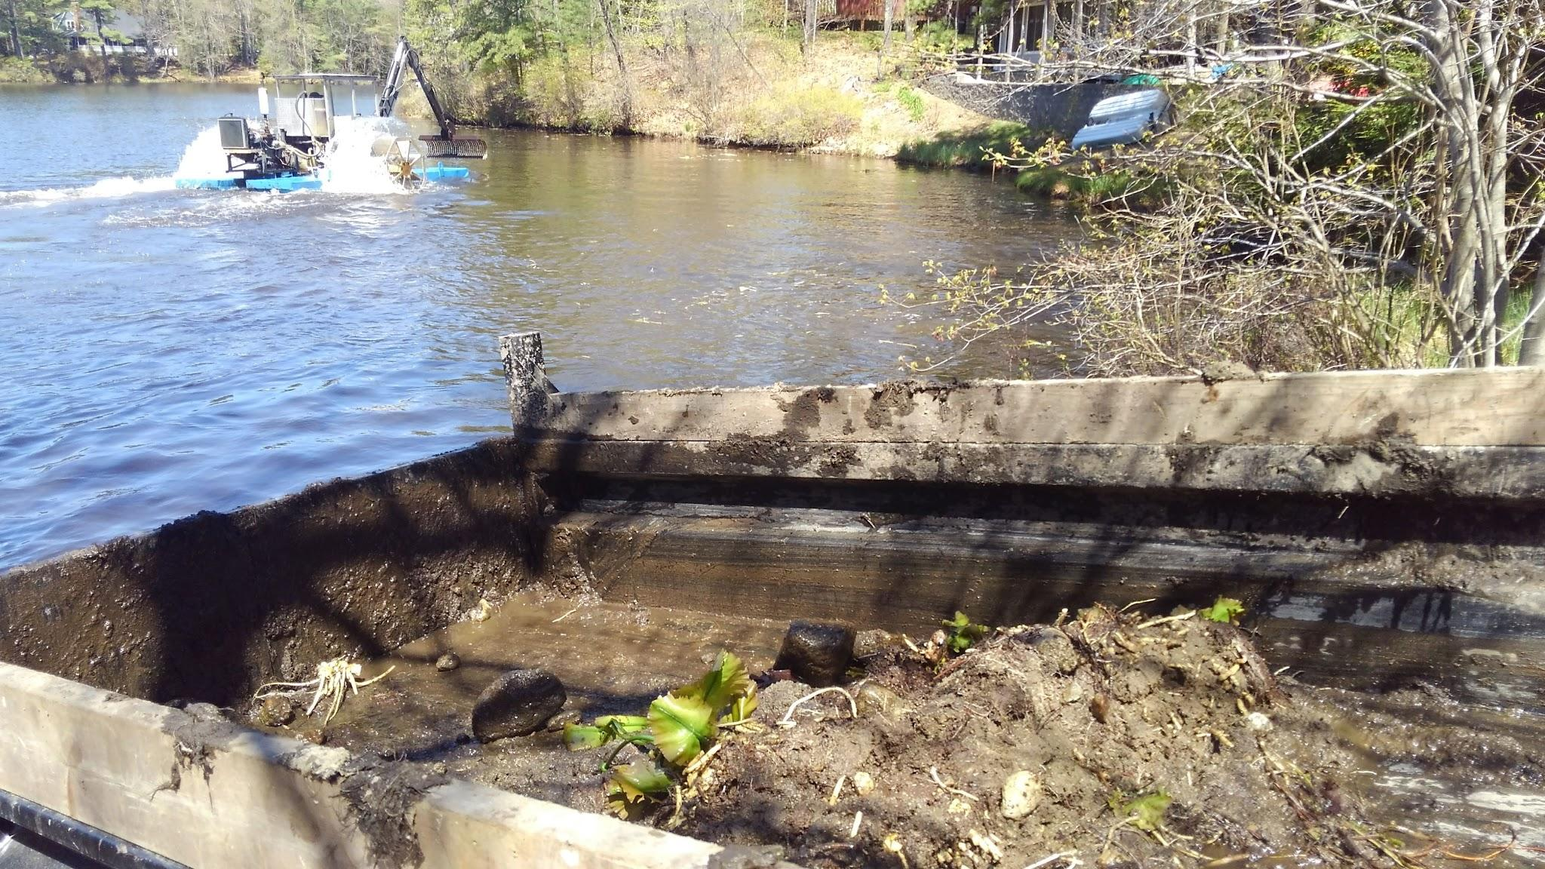
Hydroraking May 2022

Slide 27
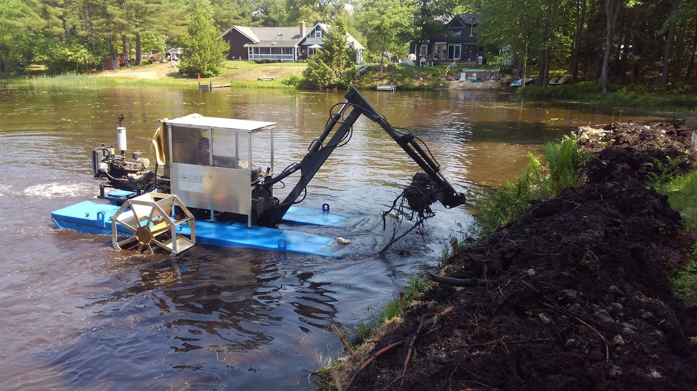
Shore owners could sign up to clean up their own access

Slide 28
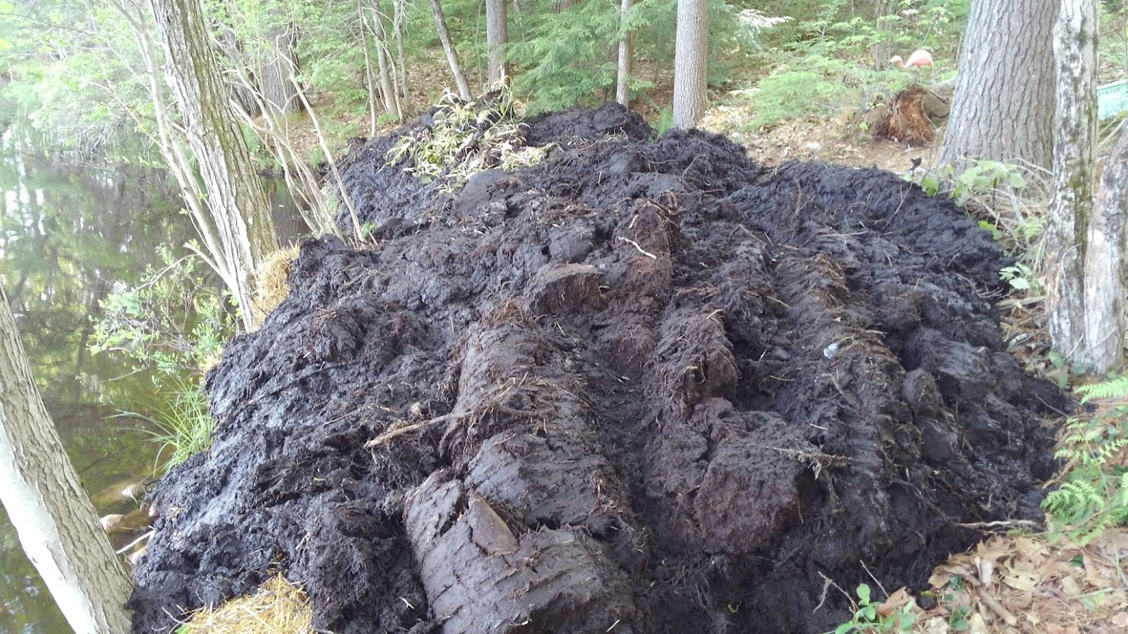
But dealing with moving the muck away from the shore, again proved challenging.

Slide 29
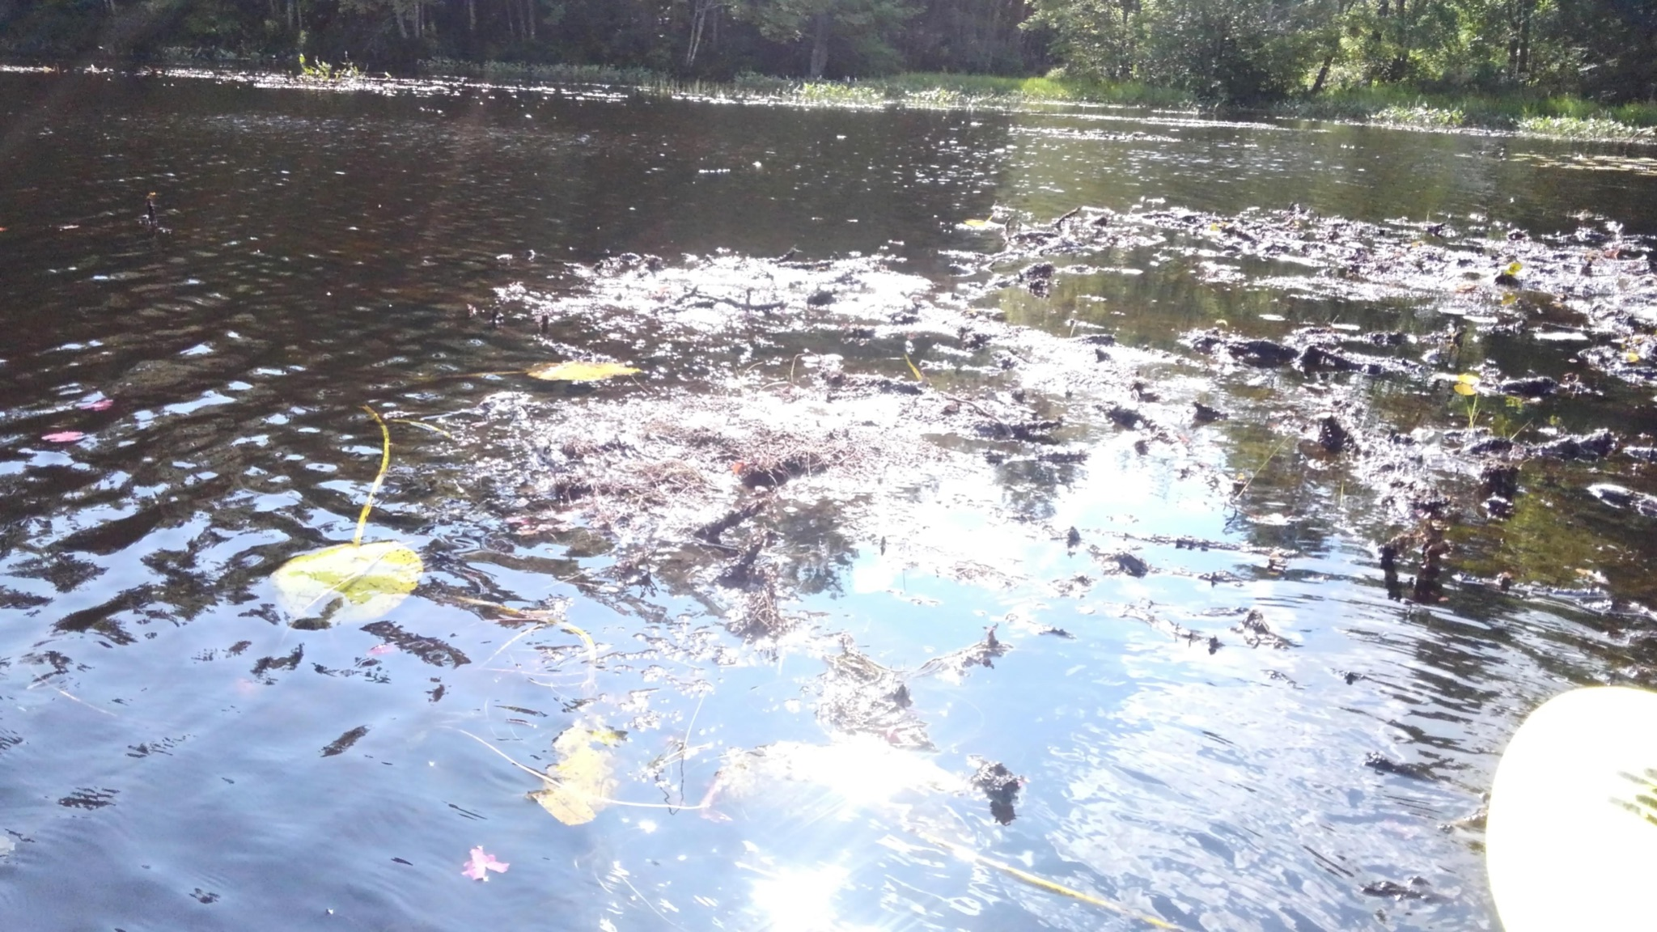
After the end of the first hydroraking in early June 2022

Slide 30
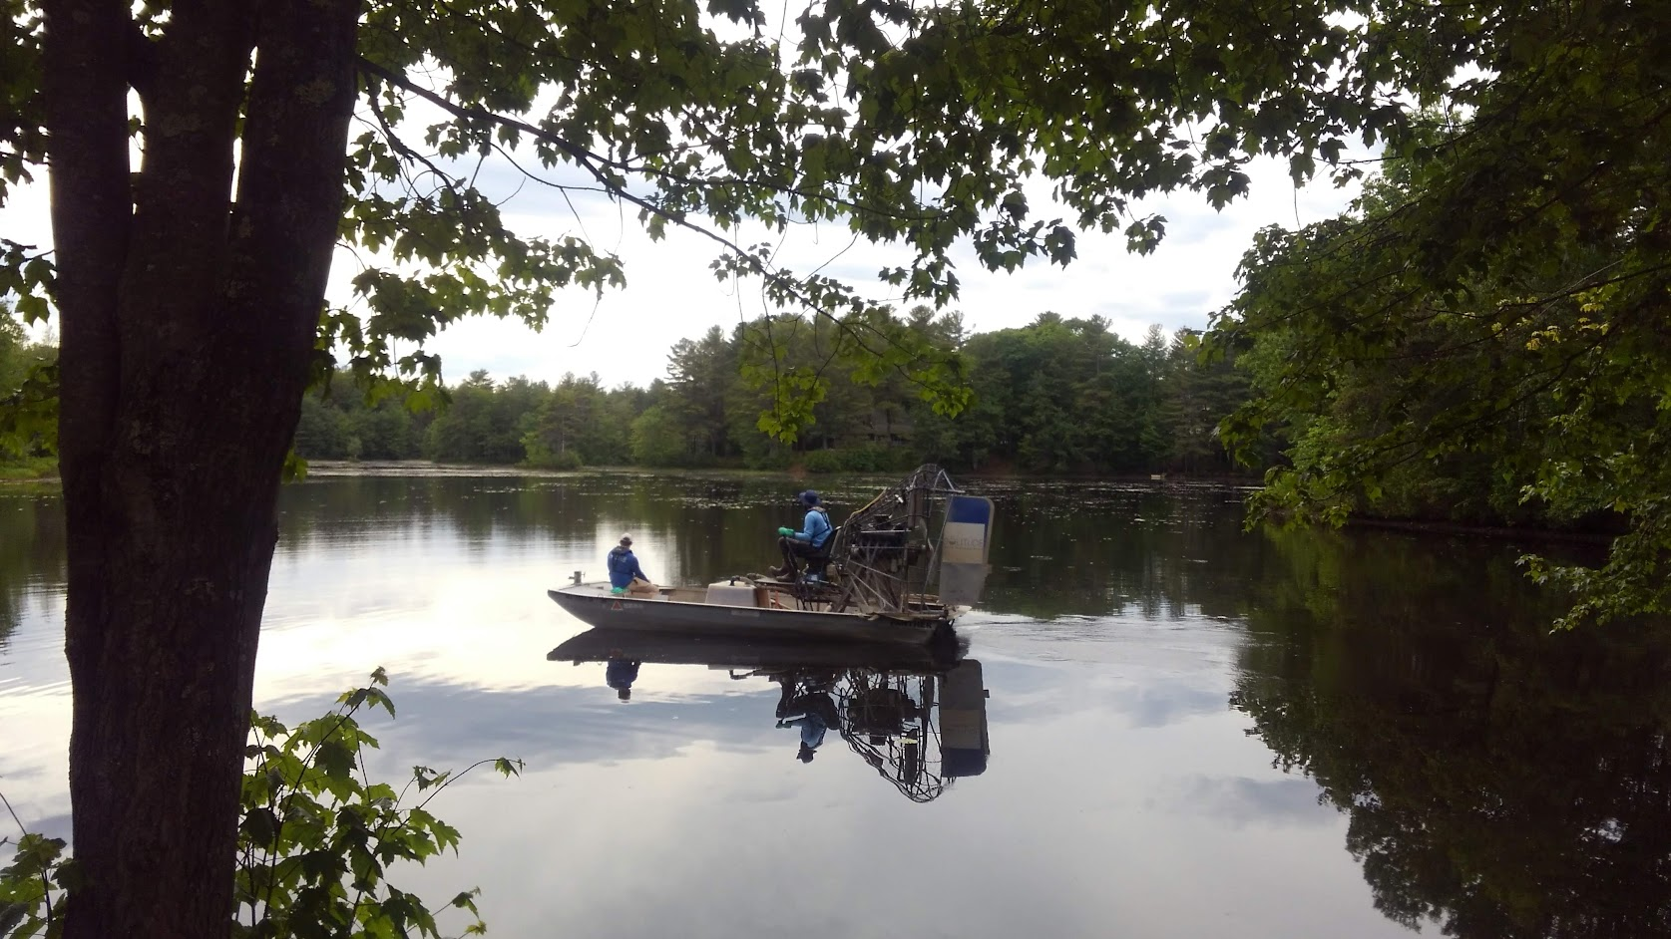
First Flurdione treatment June 2022

Slide 31
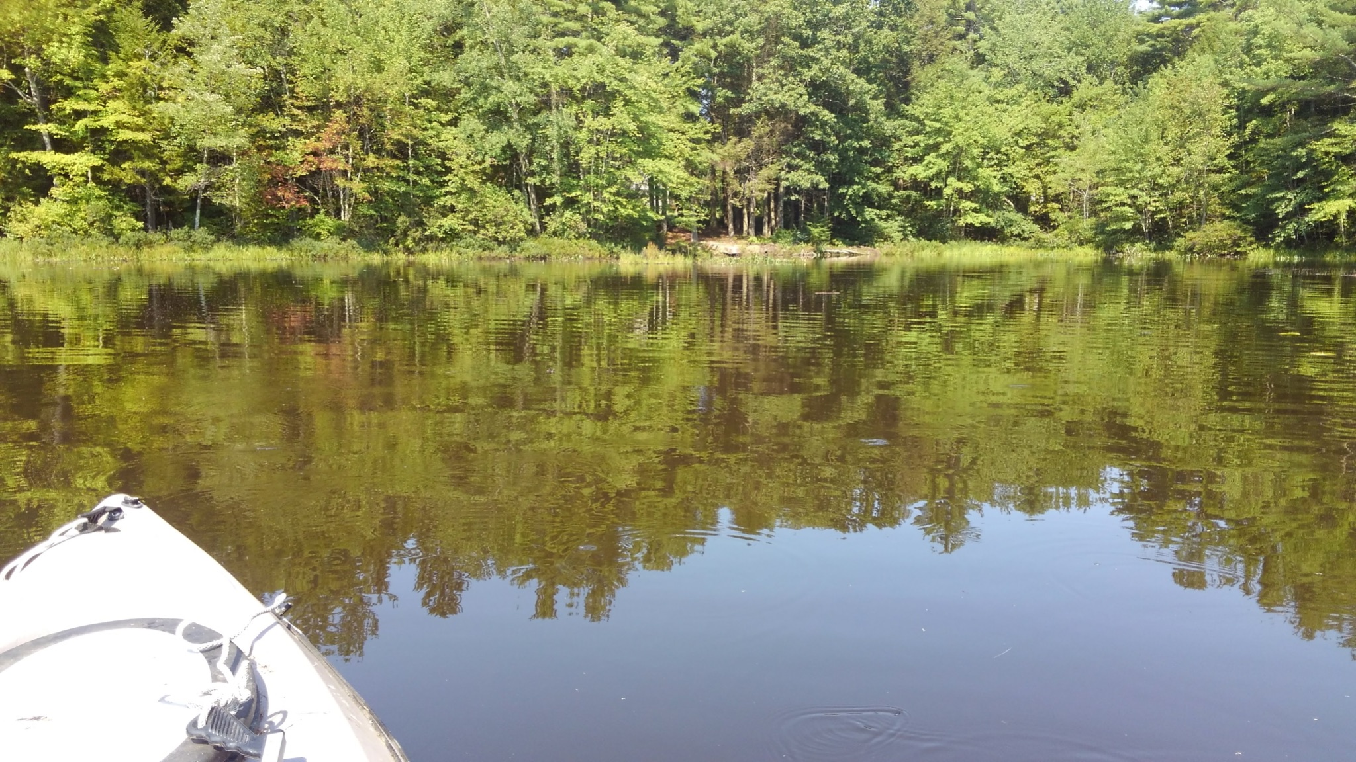
September 2022 After chemical treatment and booster and hydrorake cleanup

Slide 32
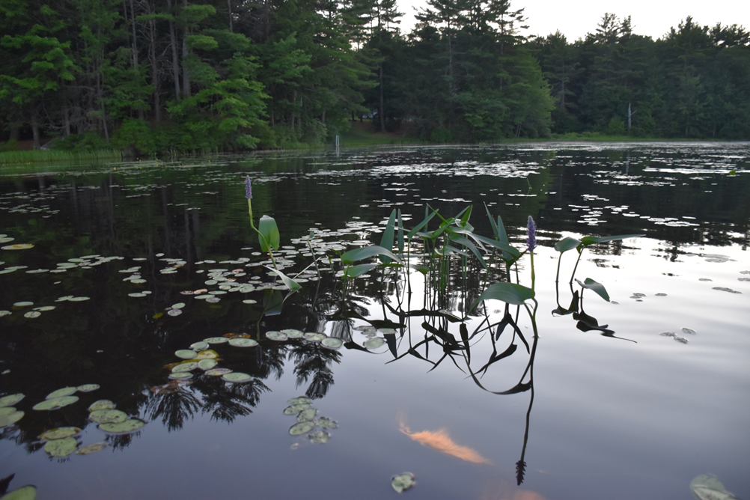
Before After

Slide 33
Summary of learnings
Wattles don't work; they get too overwhelmed. Get straw bales when dropping on shore.
Dropping on shore is very problematic. What a muddy mess! Dropping right into a machine or dump trailer is so much better. Perhaps roll off bins in the future.
Need to better educate each shore owner on what they need to do if material is going to be dropped on their shore. Number of linear feet per hour of raking appears to be 15ft/hour
Need a comprehensive plan and budget for dealing with material. May need to be $10k or more for a similar effort in the future.
Some operators were better at being aggressive and working lily roots out of rocks, but other operators cleaned up floaters better. Solitude left a lot of floating mud and lilies.
One advantage of deploying a harvester is it could clean up floaters.
Solitude's communication with us and especially answering email or voice was absolutely horrible and unprofessional once we signed the contract.
Operators did not always follow instructions.

Slide 34
Before (October 2021)

Slide 35
After (October 2022)

Slide 36
New Business
Replace Swing Set
Trail maintenance
Lodge rental coordinator

Slide 37
Installed!

Slide 38
FY 2024 Budget Proposal

Slide 39
PROPOSED 2024 BUDGET
EXPENSES | BUDGET |  | INCOME | BUDGET
Town Real Estate Taxes | $ 1,700.00 |  | Maint Fees (Plan: 185 x $200) | $ 37,000.00
Porta Potti @ Beach | $ 800.00 |  | Past Due Maint Fees / Interest | $ 63,000.00
Charter Communications | $ 3,450.00 |  | Lodge Rentals | $ 500.00
National Grid (Electric) | $ 1,300.00 |  | Interest (GFA Checking) | $ 7.00
Trash (E.L. Harvey and Sons & Republic) | $ 500.00 |  | Interest (GFA Savings) | $ 2.00
Security Alarm Systems | $ 260.00 |  | Dock Fees | $ 150.00
USPS (Stamps) | $ 200.00 |  | TOTAL INCOME | $ 100,659.00
Broberg Insurance (Liability & Lodge) | $ 6,625.75
Huhtula Oil (Fuel) | $ 2,000.00
PO Box Annual Renewal | $ 70.00
E.coli Test (Nashoba Analytical) | $ 350.00 |  | TOTAL INCOME | $ 100,659.00
Web Site Hosting Renewal | $ 175.00
Tax Accountant | $ 800.00
Mailings/Meeting Supplies | $ 500.00
Spring Cleanup/Annual Beach Party | $ 500.00
TOTAL OPERATING EXPENSES | $ 19,230.75
MAINTENANCE & IMPROVEMENTS | BUDGET
Lodge cleaning & supplies | $ 200.00
General Repairs & Maintenance | $ 3,000.00
Fuel / Supplies for Mowing, etc. | $ 100.00
Swing set for Beach | $ 5,350.00
TOT. MAINTENANCE & IMPROVEMENTS | $ 8,650.00
TOTAL EXPENSES | $ 27,880.75

Slide 40
Voting
2024-2025 Annual Maintenance and Deed Assessment Fee
PPOA Board of Directors

Slide 41
2024-2025 Annual Maintenance and Deed Assessment Fee. Current fee is just $200 per year.
Board of Directors recommendation: Keep the fee at $200 per year.

Slide 42
Vote For PPOA Board Of Directors
PPOA Members vote for the Board of Directors. The BOD elects the officers at the following monthly meeting.
Current elected board and current positions:
President: Bill Homans (Expires 2023)
Treasurer: Gail Orciuch
Clerk: Dennis Majikas (Exp. 2023) / Jim Ellis Assistant
Directors: Josh Adams (Exp. 2024) Dave Blad (Exp. 2023) Bob Brooks (Exp. 2023) John Day (Exp. 2023) Jeanne Carter (Exp. 2024) Lee Carter (Exp. 2024) Bill Poudrier (Exp. 2023)
Associate: Jim Ellis, Tim Humphrey
Webmaster: Brendon Toupense
In addition to the BOD, volunteers are always needed and much appreciated.

Slide 43
Important Dates to Remember
August 19, 2023 Annual Beach Party
September 9, 2023 Fall Clean-Up
April 1, 2024 Annual Dues Due
May 5, 2024 Annual Meeting
May 18, 2024 Spring Clean-Up
Watch signboards for upcoming Friendship Fireplaces dates!

Slide 44
Q & A

Slide 45
Thank You

Slide 46
Addendum

Slide 47
POND MAINTENANCE ACCOUNTING
DATE | POND MAINTENANCE/TREATMENTS | AMOUNT:
1/26/2021 | Hydroraking Deposit | $3,700.00
4/3/2021 | Notice Prep of Intent for CONCOM & MassDEP | $4,460.00
4/3/2021 | Town/State Filing Fee, Abutter Notifications, Town Legal Notice, Postage | $804.18
6/3/2022 | Five days Hydroraking | $5,550.00
6/24/2022 | Sonar Treatment on 6/6/22 | $3,852.00
8/7/2022 | Sonar Booster Application on 7/13/22 | $2,286.00
1/14/2023 | Weed Treatment on 9/7/2022 | $2,286.00
 | PAYMENTS PPOA TO SOLITUDE MGMT | $22,938.18
5/13/2022 | Deposit Home Owners Hydroraking | $4,000.00
9/15/2022 | Hyrdroraking payment for Home Owners | $16,000.00
12/22/2022 | Final payment from Home Owners | $1,350.00
 | PAYMENTS HOME OWNERS TO SOLITUDE MGMT | $21,350.00
 | SUBTOTAL PAYMENTS TO SOLITUDE MGMT: | $44,288.18
4/22/2022 | Wattle Barriers - Pipe Plus (J. Ellis) | $334.69
6/11/2022 | Straw Bales - S&M Farms (J. Ellis) | $161.75
6/11/2022 | Stakes - S&M Farms (J. Goguen) | $34.00
6/16/2022 | Backhoe Repairs - Bischoff & Sons (B. Homans) | $1,778.02
6/18/2022 | Fuel for Backhoe - Alltown (L. Carter) | $51.01
8/7/2022 | Excavator & Backhoe Usage (D. Blad) | $3,250.00
9/15/2022 | Hay Bales - Tractor Supply (J. Ellis) | $26.97
12/10/2022 | Backhoe & Tractor usage (D. Blad) | $695.00
 | PAYMENTS OTHER (PPOA) | $6,331.44
 | TOTAL PAYMENTS POND MAINTENANCE/TREATMENTS: | $50,619.62

Slide 48
MAINTENANCE & IMPROVEMENTS SUMMARY (FY'2023)
MAINTENANCE & IMPROVEMENTS SUMMARY (FY'2023) | MONTH | AMOUNT
Lodge Lawn Mower Maint & Fuel | April | $89.13
Sand Delivered @ Beach | August | $728.74
Deposit new Playset ($500), New Keys for Gate @ Beach ($11.65) | September | $511.65
Lodge Window Repair & Lights for Kitchen & Ladies Bathroom, Fire Exit Signs | November | $376.11
Sense Energy Monitor for Lodge | December | $317.69
Two invoices for Sontag Pump Co for Well Line Repair | December | $2,417.00
Well Line Repair (Excavation Work - D. Blad) | January | $1,325.00
 |  | $5,765.32

Slide 49
Accounts as of March 31, 2023
ACCOUNT | BALANCE | PORTFOLIO TOTAL
GFA Checking | $16,507.23
GFA Savings | $3,243,84 | $19,751.07
Edward Jones Investments | $38,873.81 | $238,874.00
Total |  | $258,625.07

Slide 50
By-Laws of
Pinecrest Property Owners Association
Adopted June 6, 1970
Amended February 1, 2009
Ratified May 3, 2009
Amended and Ratified
May 4, 2014
Article I
Name, Location, Corporate Seal
Section 1. The name of the Corporation is Pinecrest Property Owners Association, Inc.
Section 2. The principal office shall be located at The Pinecrest Lodge 84 Bemis Road, Hubbardston Massachusetts.
Section 3. The corporate seal shall be circular in form and have inscribed thereon the name of the Corporation, year of its incorporation and the word “Massachusetts”.
Article II
Purpose
Section 1. To promote and foster the recreation, relaxation, health and fellowship of the members and to hold, maintain and improve land in Wachusett Shores and Pinecrest areas in Hubbardston, Massachusetts, particularly the recreational areas and the park and to represent the members if and when the need arises in order to protect their rights and privileges and to do any and all things which may be necessary to carry out the foregoing.
Article III
Corporate Powers
Section 1. The Corporation shall have all of the powers and enjoy all of the privileges granted by the Laws of Massachusetts to Corporations organized under Chapter 180 of the General Laws.
Notes:
By-Laws of
Pinecrest Property Owners Association
Adopted June 6, 1970
Amended February 1, 2009
Ratified May 3, 2009
Amended and Ratified
May 4, 2014
Article I
Name, Location, Corporate Seal
Section 1. The name of the Corporation is Pinecrest Property Owners Association, Inc.
Section 2. The principal office shall be located at The Pinecrest Lodge 84 Bemis Road, Hubbardston Massachusetts.
Section 3. The corporate seal shall be circular in form and have inscribed thereon the name of the Corporation, year of its incorporation and the word “Massachusetts”.
Article II
Purpose
Section 1. To promote and foster the recreation, relaxation, health and fellowship of the members and to hold, maintain and improve land in Wachusett Shores and Pinecrest areas in Hubbardston, Massachusetts, particularly the recreational areas and the park and to represent the members if and when the need arises in order to protect their rights and privileges and to do any and all things which may be necessary to carry out the foregoing.
Article III
Corporate Powers
Section 1. The Corporation shall have all of the powers and enjoy all of the privileges granted by the
Laws of Massachusetts to Corporations organized under Chapter 180 of the General Laws.
Article IV
Membership
Section 1. Any persons owning an interest in one or more lots or parcels of land in Hubbardston,
Worcester County, Massachusetts and sold by American Central Company, a Massachusetts Trust under declaration of trust dated as of June 18, 1964, recorded with Worcester District Registry of Deeds, Book 4473 at Page 309 shall be eligible for membership in the Corporation and shall be entitled to one vote regardless of the number of lots owned by said persons.
Article V
Officers and Directors
Section 1. The officers of the Corporation shall be the president, treasurer, clerk and the Board of Directors. They shall consist of not less than three stockholders, and except as otherwise provided in these By-Laws shall be electedat the annual meeting and servefor Two Years and until their successors are elected and qualified. The Board of Directors shall elect the president from their own number and may from time to time appoint such additional officers, agents and committees, as they shall consider necessary.
Section 2. The president shall preside at all meetings of stockholders and Board of Directors.
Section 3. The treasurer shall give bond if and when required by the Board of Directors, shall have custody of the stock and transfer books and corporate seal, and shall receive and disburse the funds of the Corporation under the direction of the Board of Directors.
Section 4. The clerk shall keep records, call all meetings and such other duties as may be required by the Board of Directors.
Section 5. The Board of Directors shall have and exercise full control and management of the affairs and business of the Corporation, except such as are conferred by law upon the stockholders or upon an officer of the Corporation or may be delegated to a committee. They shall have power to fill all vacancies.
Article VI
Committees
Section 1. Committees shall be appointed by the Board of Directors as deemed necessary, and shall consist of but not be limited to the following: Ways and Means, Entertainment and Hospitality, Membership, Young People, Children, Building Control, Bylaws, and Finance. One representative from each said subcommittee shall provide a progress report to the Board of Directors at their monthly meetings.
Article VII
Meetings
Section 1. The annual meeting of the members shall be held at the office of the Corporation on the first Sunday of May in each year or on a date determined by the Board of Directors and fifteen (15) members shall constitute a quorum.
Section 2. Special meetings of the members may be held as provided by law, but no business other than formal business shall be transacted unless set forth in the notice of said meeting.
Section 3. The Board of Directors may fix the time and method of calling their monthly meetings.
Section 4. A detailed hard copy financial report will be provided to all stockholders at the annual stockholder meeting.
Article VIII
Fiscal Year
Section 1. The fiscal year of the Corporation shall be from April 1 to March 31.
Article IX
Annual Dues
Section 1. The annual membership and deed assessment fee shall be determined by a majority vote of the members at the annual meeting.
Section 2. The annual membership and deed assessment fee will be due on April 1st.
Section 3. Any member neglecting to pay the annual membership and deed assessment fee by June 1st may have his or her annual membership terminated after notification by the clerk and upon vote of the Board of Directors.
Article X
Contracts, Checks and Notes
Section 1. The Board of Directors shall designate which officer or officers shall sign contracts, checks and notes. No officer other than the person or persons so designated shall have the power to bind the Corporation.
Section 2. Any expenditure above three hundred dollars ($300.00), beyond the fixed annual expenses
Shall be approved by the Board of Directors.
Section 3. Any non-emergency expenditure above ($3000.00) shall be brought to the annual meeting and voted on by the owners.
Article XI
INDEMNIFICATION OF DIRECTORS AND OFFICERS
Section 1 Definitions.For purposes of this Article the following terms shall have the following meanings:
“Director/Officer” means any person who is serving or has served as a Director, Officer or employee or other agent of the Corporation appointed or elected by the Board of Directors of the Corporation, who is serving or has served at the request of the Corporation as a Director, Officer, trustee, principal, partner, member of a committee, employee or other agent of any other organization, or in any capacity with respect to any employee benefit plan of the Corporation or any of its subsidiaries.
“Proceeding”
means action, suit or proceeding, whether civil, criminal, administrative or investigative, brought or threatened in or before any court, tribunal, administrative or legislative body or agency, and any claim which could be the subject of a Proceeding.
“Expense”
means any fine or penalty, and any liability fixed by a judgment, order, decree or award in a Proceeding, any amount reasonably paid in settlement of a Proceeding and any professional fees and other disbursements reasonably incurred in connection with a Proceeding.
Section 2 Right to Indemnification.
Except as limited by law or as provided in Section 3 and 4 of this Article XI, each
Director/Officer (and his or her heirs and personal representatives) shall be indemnified by the Corporation against any Expense incurred by him or her in connection with each Proceeding in which he or she is involved as a result of serving or having served as a Director/Officer.
Section 3 Indemnification not Available.
No indemnification shall be provided to a Director/Officer with respect to a Proceeding as to which it shall have been adjudicated that he or she did not act in good faith in the reasonable belief that his or her action was in the best interests of the Corporation.
Section 4 Compromise or Settlement.
In the event that a Proceeding is compromised or settled so as to impose any liability or obligation on a Director/Officer or upon the Corporation, no indemnification shall be provided as to said Director/Officer with respect to such Proceeding if such Director/Officer shall have been adjudicated not to have acted in good faith in the reasonable belief that his or her action was in the best interests of the Corporation.
Section 5 Advances.
The Corporation shall pay sums on account of indemnification in advance of a final disposition of a Proceeding upon receipt of an undertaking by the Director/Officer to repay such sums if it is subsequently established that he or she is not entitled to indemnification pursuant to Sections 3 and 4 hereof, which undertaking may be accepted without reference to the financial ability of such person to make repayment.
Section 6 Not Exclusive.
Nothing in this Article XI shall limit any lawful rights to indemnification existing independently of this Article XI.
Section 7 Insurance.
The provisions of this Article XI shall not limit the power of the Board of Directors to authorize the purchase and maintenance of insurance on behalf of any Director/Officer against any Expense incurred by him or her in any such capacity, or arising out of his or her status as such, whether or not the Corporation would have the power to indemnify him or her against such Expense under this Article XI.
Section 8 Amendment.
The provisions of this Article XI may be amended or repealed by the Board of Directors; however, no amendment or repeal of such provisions which adversely affects the rights of a Director/Officer under this Article XI with respect to his or her acts or omissions prior to such amendment or repeal shall apply to him or her without his or her consent.
Article XII
Amendments
Section 1. These By-Laws may be altered, amended or repealed at any annual, regular or special meeting
duly called, by the affirmative vote of two-thirds of the members present and voting, provided that written notice and copies of such proposed amendments or revisions shall have been given to all members ninety (90) days at least before said meeting.

Slide 51
Article IV
Membership
Section 1. Any persons owning an interest in one or more lots or parcels of land in Hubbardston,
Worcester County, Massachusetts and sold by American Central Company, a Massachusetts Trust under declaration of trust dated as of June 18, 1964, recorded with Worcester District Registry of Deeds, Book 4473 at Page 309 shall be eligible for membership in the Corporation and shall be entitled to one vote regardless of the number of lots owned by said persons.
Article V
Officers and Directors
Section 1. The officers of the Corporation shall be the president, treasurer, clerk and the Board of Directors. They shall consist of not less than three stockholders, and except as otherwise provided in these By-Laws shall be electedat the annual meeting and servefor Two Years and until their successors are elected and qualified. The Board of Directors shall elect the president from their own number and may from time to time appoint such additional officers, agents and committees, as they shall consider necessary.
Section 2. The president shall preside at all meetings of stockholders and Board of Directors.
Section 3. The treasurer shall give bond if and when required by the Board of Directors, shall have custody of the stock and transfer books and corporate seal, and shall receive and disburse the funds of the Corporation under the direction of the Board of Directors.
Section 4. The clerk shall keep records, call all meetings and such other duties as may be required by the Board of Directors.
Section 5. The Board of Directors shall have and exercise full control and management of the affairs and business of the Corporation, except such as are conferred by law upon the stockholders or upon an officer of the Corporation or may be delegated to a committee. They shall have power to fill all vacancies.

Slide 52
Article VI
Committees
Section 1. Committees shall be appointed by the Board of Directors as deemed necessary, and shall consist of but not be limited to the following: Ways and Means, Entertainment and Hospitality, Membership, Young People, Children, Building Control, Bylaws, and Finance. One representative from each said subcommittee shall provide a progress report to the Board of Directors at their monthly meetings.
Article VII
Meetings
Section 1. The annual meeting of the members shall be held at the office of the Corporation on the first Sunday of May in each year or on a date determined by the Board of Directors and fifteen (15) members shall constitute a quorum.
Section 2. Special meetings of the members may be held as provided by law, but no business other than formal business shall be transacted unless set forth in the notice of said meeting.
Section 3. The Board of Directors may fix the time and method of calling their monthly meetings.
Section 4. A detailed hard copy financial report will be provided to all stockholders at the annual stockholder meeting.
Article VIII
Fiscal Year
Section 1. The fiscal year of the Corporation shall be from April 1 to March 31.

Slide 53
Article IX
Annual Dues
Section 1. The annual membership and deed assessment fee shall be determined by a majority vote of the members at the annual meeting.
Section 2. The annual membership and deed assessment fee will be due on April 1st.
Section 3. Any member neglecting to pay the annual membership and deed assessment fee by June 1st may have his or her annual membership terminated after notification by the clerk and upon vote of the Board of Directors.
Article X
Contracts, Checks and Notes
Section 1. The Board of Directors shall designate which officer or officers shall sign contracts, checks and notes. No officer other than the person or persons so designated shall have the power to bind the Corporation.
Section 2. Any expenditure above three hundred dollars ($300.00), beyond the fixed annual expenses
Shall be approved by the Board of Directors.
Section 3. Any non-emergency expenditure above ($3000.00) shall be brought to the annual meeting and voted on by the owners.

Slide 54
Article XI
INDEMNIFICATION OF DIRECTORS AND OFFICERS
Section 1 Definitions.For purposes of this Article the following terms shall have the following meanings:
“Director/Officer” means any person who is serving or has served as a Director, Officer or employee or other agent of the Corporation appointed or elected by the Board of Directors of the Corporation, who is serving or has served at the request of the Corporation as a Director, Officer, trustee, principal, partner, member of a committee, employee or other agent of any other organization, or in any capacity with respect to any employee benefit plan of the Corporation or any of its subsidiaries.
“Proceeding”
means action, suit or proceeding, whether civil, criminal, administrative or investigative, brought or threatened in or before any court, tribunal, administrative or legislative body or agency, and any claim which could be the subject of a Proceeding.
“Expense”
means any fine or penalty, and any liability fixed by a judgment, order, decree or award in a Proceeding, any amount reasonably paid in settlement of a Proceeding and any professional fees and other disbursements reasonably incurred in connection with a Proceeding.
Section 2 Right to Indemnification.
Except as limited by law or as provided in Section 3 and 4 of this Article XI, each
Director/Officer (and his or her heirs and personal representatives) shall be indemnified by the Corporation against any Expense incurred by him or her in connection with each Proceeding in which he or she is involved as a result of serving or having served as a Director/Officer.
Section 3 Indemnification not Available.
No indemnification shall be provided to a Director/Officer with respect to a Proceeding as to which it shall have been adjudicated that he or she did not act in good faith in the reasonable belief that his or her action was in the best interests of the Corporation.
Section 4 Compromise or Settlement.
In the event that a Proceeding is compromised or settled so as to impose any liability or obligation on a Director/Officer or upon the Corporation, no indemnification shall be provided as to said Director/Officer with respect to such Proceeding if such Director/Officer shall have been adjudicated not to have acted in good faith in the reasonable belief that his or her action was in the best interests of the Corporation.

Slide 55
Section 5 Advances.
The Corporation shall pay sums on account of indemnification in advance of a final disposition of a Proceeding upon receipt of an undertaking by the Director/Officer to repay such sums if it is subsequently established that he or she is not entitled to indemnification pursuant to Sections 3 and 4 hereof, which undertaking may be accepted without reference to the financial ability of such person to make repayment.
Section 6 Not Exclusive.
Nothing in this Article XI shall limit any lawful rights to indemnification existing independently of this Article XI.
Section 7 Insurance.
The provisions of this Article XI shall not limit the power of the Board of Directors to authorize the purchase and maintenance of insurance on behalf of any Director/Officer against any Expense incurred by him or her in any such capacity, or arising out of his or her status as such, whether or not the Corporation would have the power to indemnify him or her against such Expense under this Article XI.
Section 8 Amendment.
The provisions of this Article XI may be amended or repealed by the Board of Directors; however, no amendment or repeal of such provisions which adversely affects the rights of a Director/Officer under this Article XI with respect to his or her acts or omissions prior to such amendment or repeal shall apply to him or her without his or her consent.
Article XII
Amendments
Section 1. These By-Laws may be altered, amended or repealed at any annual, regular or special meeting
duly called, by the affirmative vote of two-thirds of the members present and voting, provided that written notice and copies of such proposed amendments or revisions shall have been given to all members ninety (90) days at least before said meeting.

